Slide 1

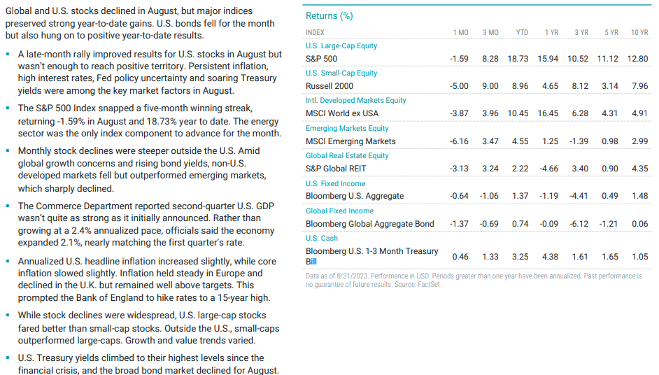
Market summary as of 8/31: Total Returns
Source: Avantis Investors, data as of 8/31/2023

Slide 2
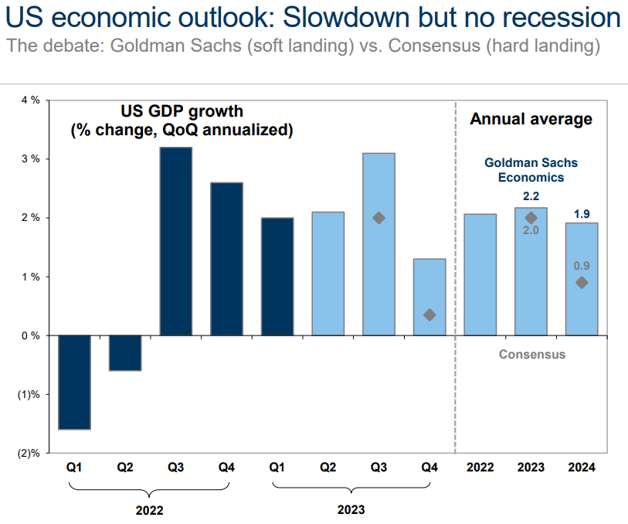
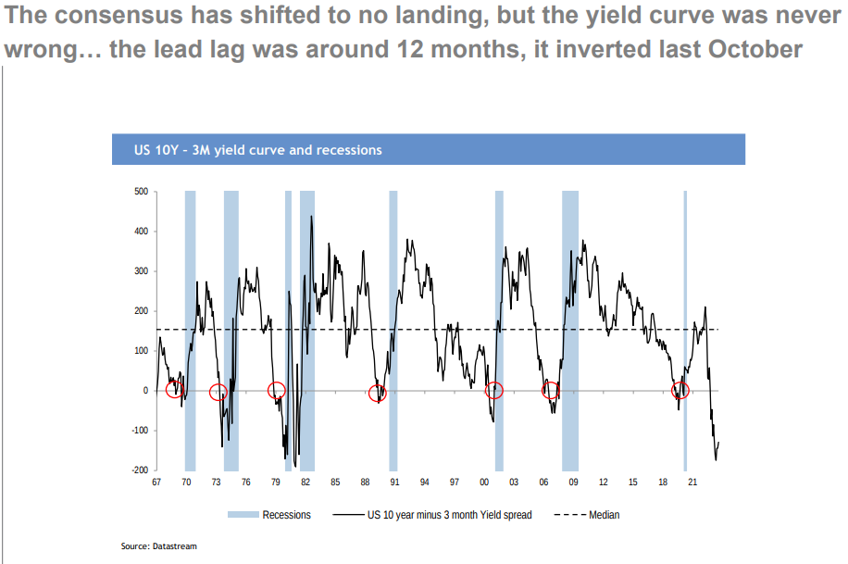
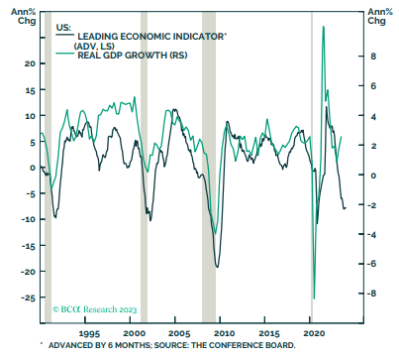
Soft or hard landing?
The consensus believes a recession will be avoided
Leading indicators and the yield curve suggest the risk are still relatively high
Kinked Phillips Curve?

Slide 3
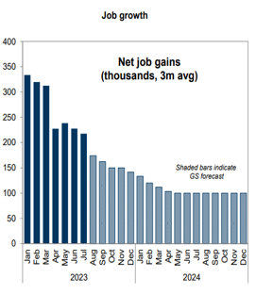
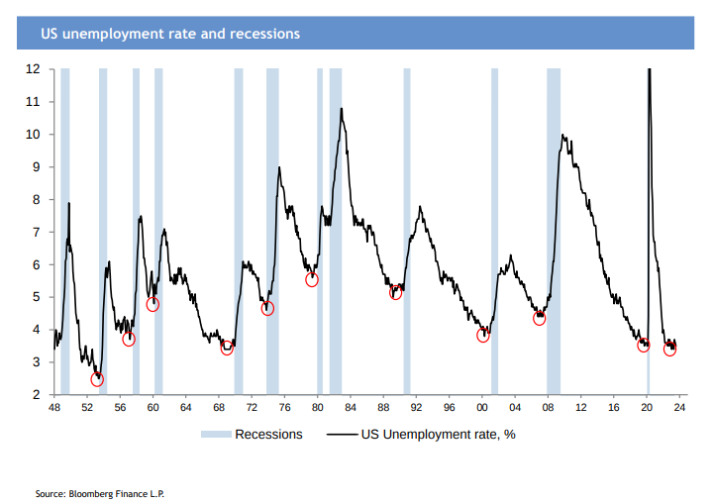
One indicator to watch: Jobs!
“If you had to pick only one indicator to watch… it would be jobs. The Fed is likely to keep rates high until something breaks… either the economy or inflation.” PIMCO
Job growth starting to slow…
Changes happen quickly…

Slide 4
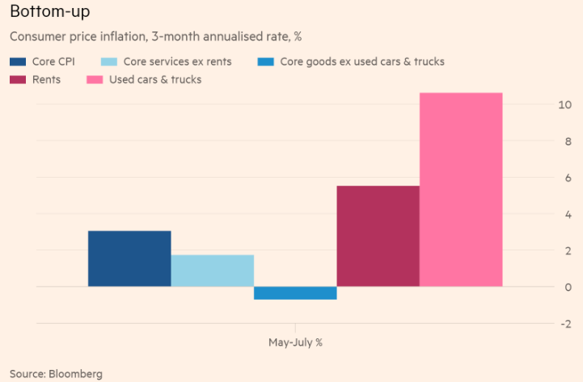
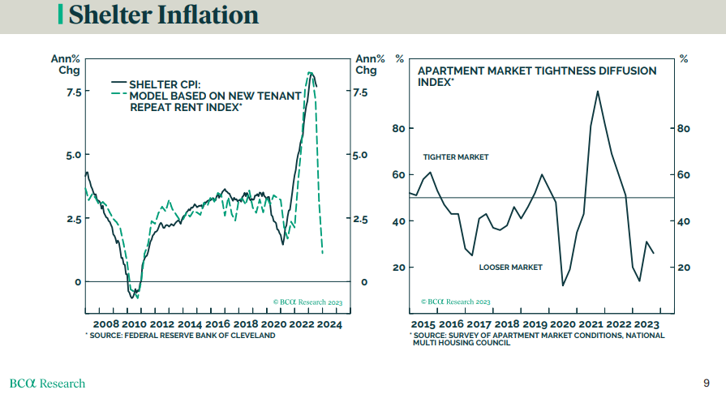
Inflation trending lower
Inflation is trending lower
The sticking point has been shelter and used cars
Models suggest they will trend lower
Shelter & used cars the exception
Models suggest they will trend lower

Slide 5
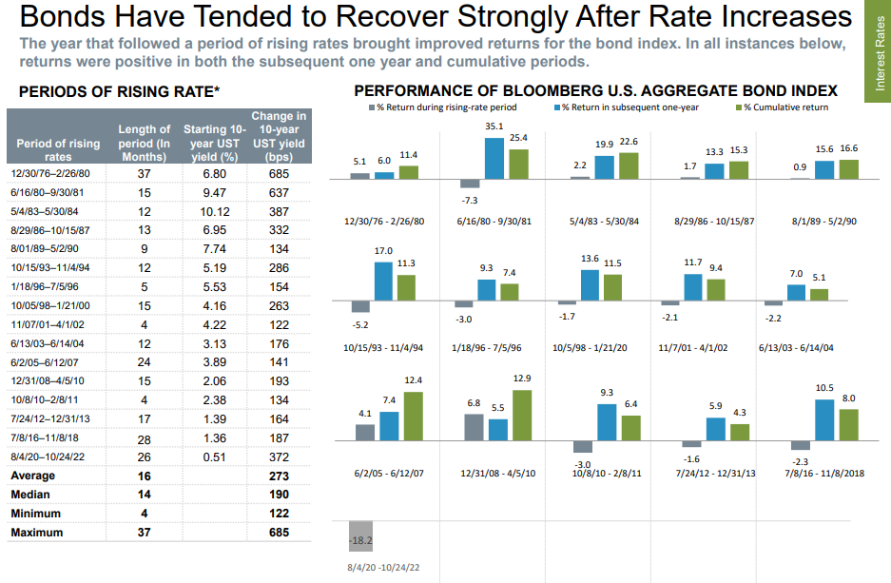
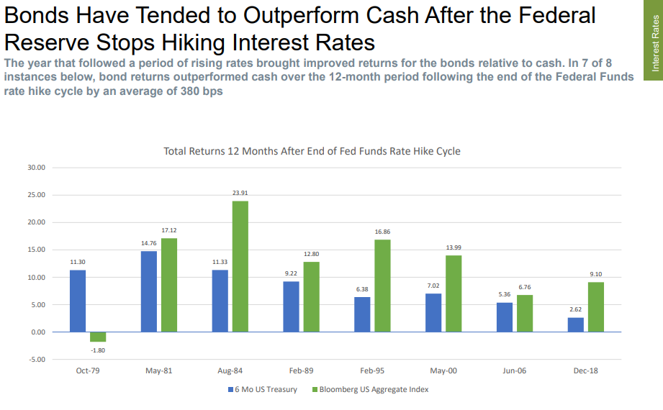
The outlook for bonds
Bonds have been strong performers after rate increases
And tend to outperform cash after the Fed stops hiking rates
Are we close to the Fed stopping? WSJ’s Nick Timiraos

Slide 6
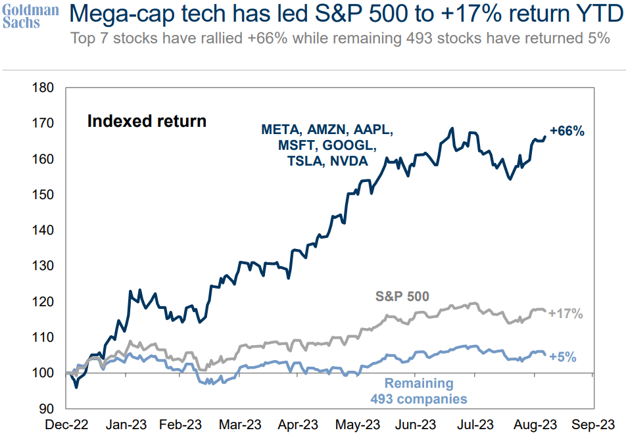
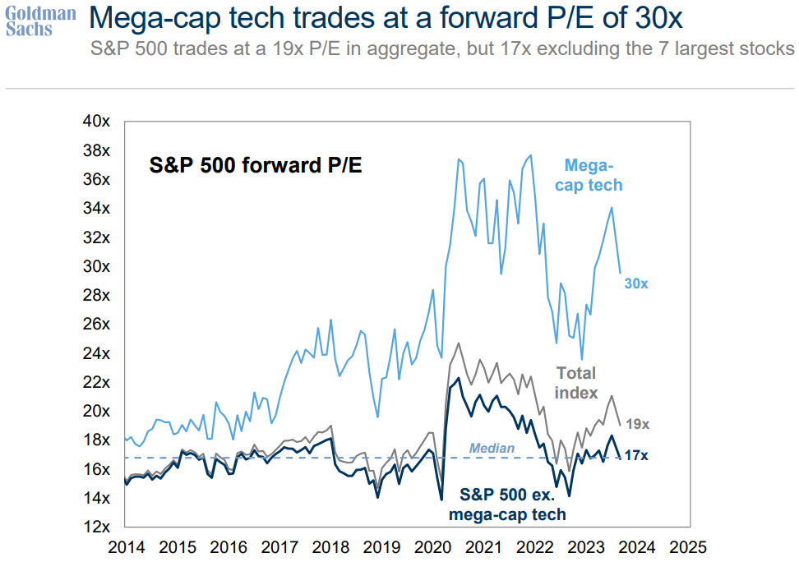
US Stocks: an unbalanced market in 2023
Returns have been very concentrated in a few stocks
The majority of stocks are flat to up slightly
Valuations on the biggest companies are very high while the remaining stocks are close to longer term averages

Slide 7
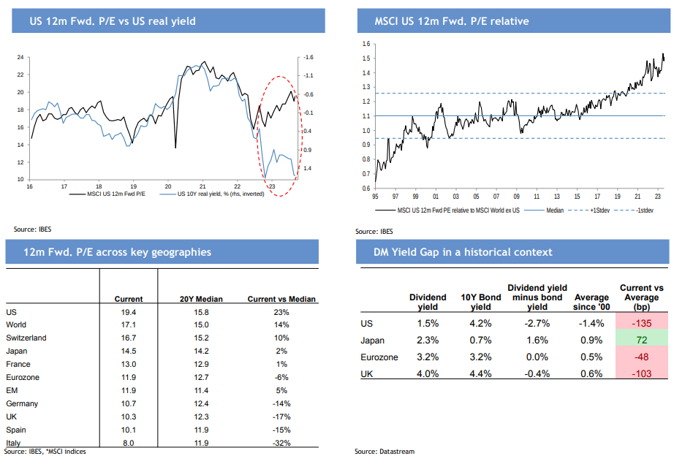
US stock market valuations are high
Valuations on US large cap stocks are historically high

Slide 8
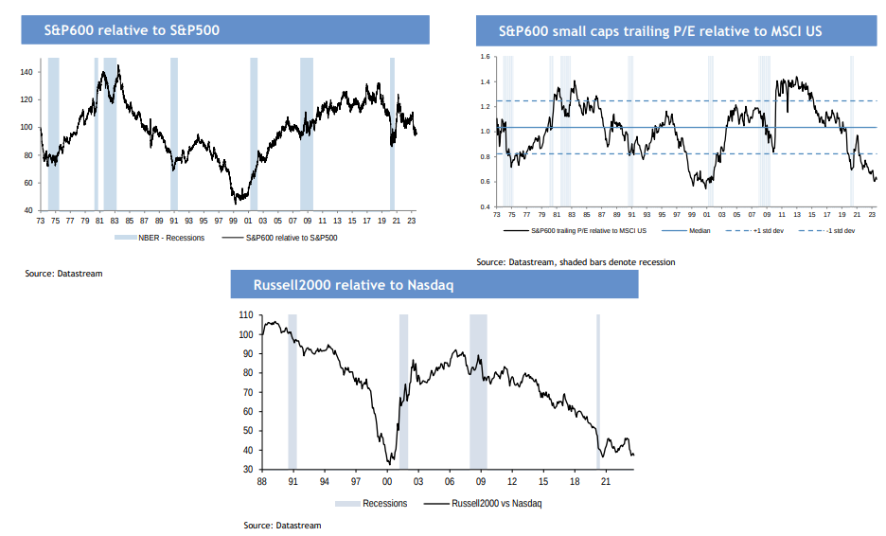
US small cap stocks are the exception
Small caps are inexpensive on a relative and absolute basis

Slide 9
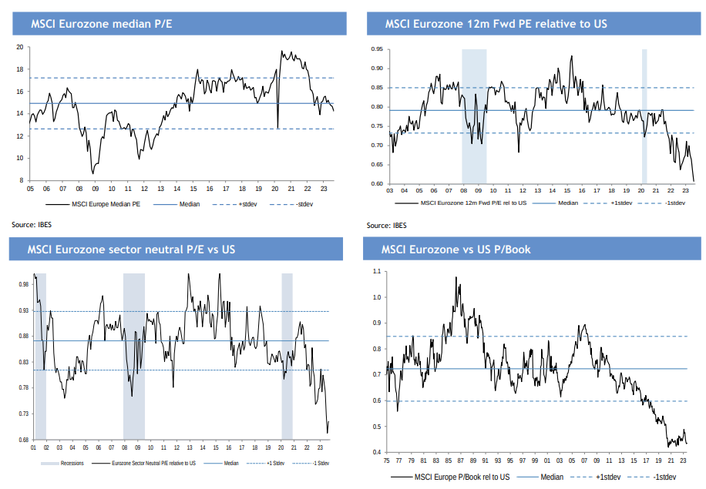
Foreign stocks are relatively inexpensive
Foreign stocks are inexpensive relative to US stocks

Slide 10
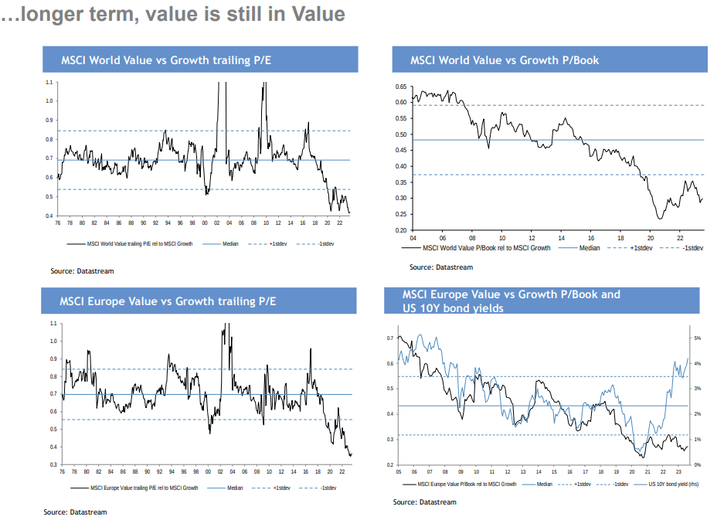
Global ‘Value’ is relatively inexpensive
Value stocks are relatively inexpensive to growth

Slide 11
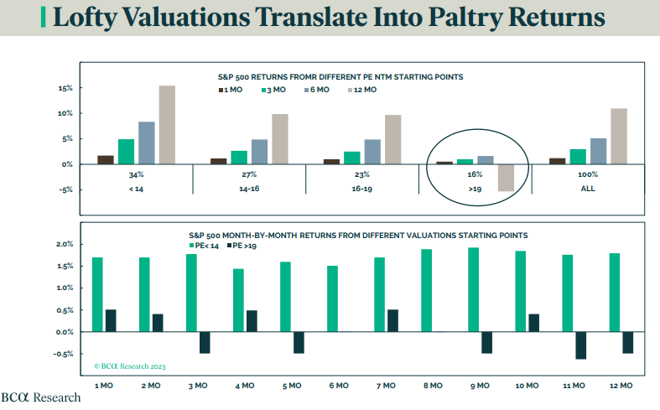
Why valuations matter

Slide 12

Closing thoughts
  Cash:
    Money market (MM) yields have risen to their highest level in many years, current yields are over 5%.
    MM’s are an excellent place to hold funds with a less than 2-year time horizon; beyond that money markets are likely to lag core bonds if/when the Fed stops and eventually cuts rates.
  Bonds:
    With interest rates at their highest yield in years, the outlook for bond returns have improved and should average close to mid single digits.
    Active management is likely to add value over a full market cycle.
  U.S. Equities:
    Returns in the US have been unbalanced; with large growth and tech overvalued; and value and small cap are attractively valued. Returns should average in the mid to high single digits, depending on allocation.
    Valuations and the potential for a recession in 2024 are potential head winds.
  International Equities:
    Attractive relative stock valuations compared to the U.S. and likely to outperform over a longer time horizon.
    Emerging markets are relatively cheap compared to U.S. stocks.
    Long-term investors will profit from overweighting foreign stocks relative to the U.S, including emerging markets. May need a catalyst and a lower $ for relative performance to improve. Returns in the high single digits.
  Alternative strategies:
    Provide diversification and a source of return independent from traditional stock and bond markets; we expect returns to be in between bonds and stocks with a lot less volatility than stocks and better returns than bonds over a full market cycle.
    Provide a hedge against increasing inflation and generate real returns; commodities, hedged equity, etc.
    We would likely eliminate alternative strategies if/when stocks became broadly undervalued and bonds had attractive real return prospects. With higher bond yields we have reduced alternative strategies.
  Risks:
    Higher inflation and interest rates than the market anticipates; Fed policy mistakes and a deep recession; valuation; China and geo-political; election cycle; cyber-attacks; tax; etc.

